Slide 1


Slide 2


THE
MESS OF THE WORLD

Slide 3

The world is a mess: war/famine/illness (pandemic)/suffering - use personal or local examples where relevant
People ask, "Where is God in the mess?”
People ask, “Why is the world a mess?”
People ask “How can we fix the mess?”
These are not new questions. Isaiah cries out Where? (Isaiah 63:15), Why? (63:17), How? (64:5)
Isaiah pleads,“Oh, that you would tear open the heavens and come down” (Isaiah 64:1)

Slide 4
THE
MESS OF CHRISTMAS

Slide 5
Jesus’ birth was a literal mess – in the stable
Jesus’ birth was a social mess – Mary and Joseph were not married, and Joseph knew he was not the father of the baby
Jesus’ birth took place in a time of societal mess – the census of the entire Roman world meant enforced upheaval, oppressive restrictions and fear for the future (similar to how we felt during the pandemic)
Jesus is no stranger to the mess we experience today

Slide 6
THE
MESS-IAH
OF CHRISTMAS

Slide 7
There is more to Christmas than just mess. There is also a Mess-iah (saviour/deliverer/liberator/rescuer)
Luke 2:10 – “Today in the town of David a Saviour has been born to you; he is the Messiah, the Lord”.
The solution to mess comes from an unlikely place – a messy baby.
Jesus is the only person who can enter into the mess of our world and begin to rebuild it, because he is the only One who is without mess.
On the cross, he took the punishment for all our mess, so that our lives might be rebuilt in him.
As Jesus tore open the heavens and came down to this earth (Isaiah 64:1), He went down to the depths of hell for us as he died on the cross. He faced God-forsakenness for us, so that we never need face it ourselves.

Slide 8
THE
MESS-AGE
OF CHRISTMAS

Slide 9
At Christmas there is the Mess, the Mess-iah and the Mess-age
The angel shares the message with the shepherds: “Do not be afraid, I bring you good news that will cause great joy” (Luke 2:10)
There are three reasons that Christmas is a message of good news that causes great joy:
The joy of gifts: It’s not about what we can give Jesus, but what he has given us.
The joy of life: We celebrate the birthdays of people who are alive, not those who are dead. The Risen Messiah has the power to bring about a mess-free world and He has the power to lead you through death to be there
The joy of names: The name “Jesus” tells us we can know God’s pardon for the past (Matthew 1:21). The name “Immanuel” tells us we can know God’s presence for the present (Matthew 1:23). The name “Son of the Most High” (Luke 1:32-33) tells us we can know God’s paradise for the future.

Slide 10
THE
MESS-AGE
FOR THE WORLD

Slide 11

The Christmas message is on offer to everyone: “Do not be afraid, I bring you good news that will cause great joy for all the people” (Luke 2:10)
The shepherds were poor; the wise men rich. The shepherds were locals; the wise men from afar. The shepherds were Jewish; the wise men pagan. Yet they both knew this message about a Messiah was relevant to them.
Jesus offers us the gift of Himself – a Messiah to deal with all our mess. He will never force us to accept the offer. He loves us and love never forces. Will we accept him as our Messiah, or leave this gift under the tree unopened?

Slide 12
THE
MESS-IAH
FOR YOU

Slide 13
We are all faced with a dilemma: “Is the baby in the manger really the Messiah come to rescue us from our mess?”
‘The shepherds said to one another “Let’s go to Bethlehem and see this thing that has happened”’ (Luke 2:15). Like the shepherds, we too can investigate
The wonder of Christmas is that God provided an emphatic answer to Isaiah’s questions:
Where? I’m here. God with you.
Why? I’m sorting out all the mess in you and in this world
How? Through being your Messiah
At the first Christmas, Jesus tore open the heavens and He came down
At the first Easter, Jesus tore open the earth and He came up
Today, are you ready to let Jesus tear open the bubble of your life and come in to be your Messiah?

Slide 14
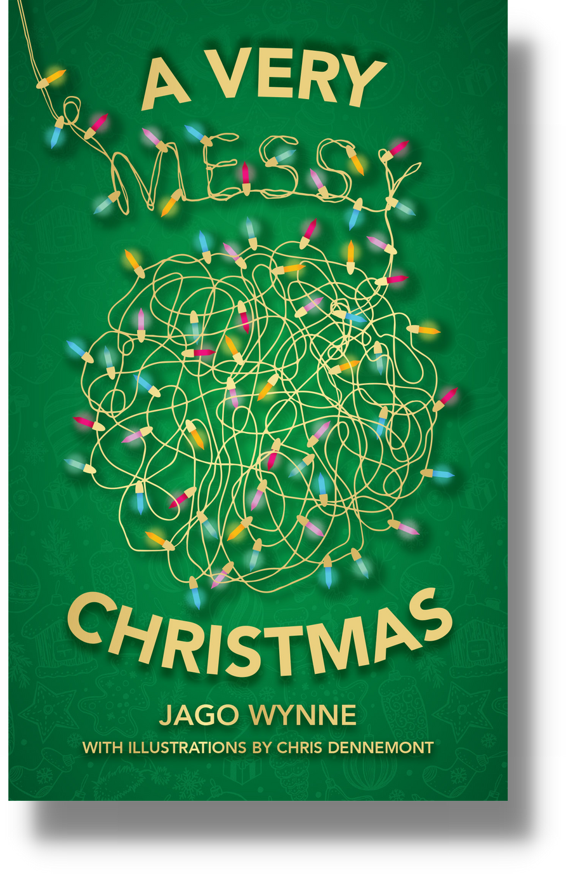

Slide 15
We hope you have a very merry Christmas.
But even more, we pray you have a very messy Christmas as you trust in the joyous message about the Messiah who deals with all our mess.

